Slide 1



Introduction to Lost & Found items software
Group Leader: Internal Faculty Guide:
>Rathod Uday >Dipika Jani
Group Members:
>Rathod Uday
>Chauhan Priyanshu
>Parmar Foram
>Rangee Dimple
>Gupta Divya

Slide 2
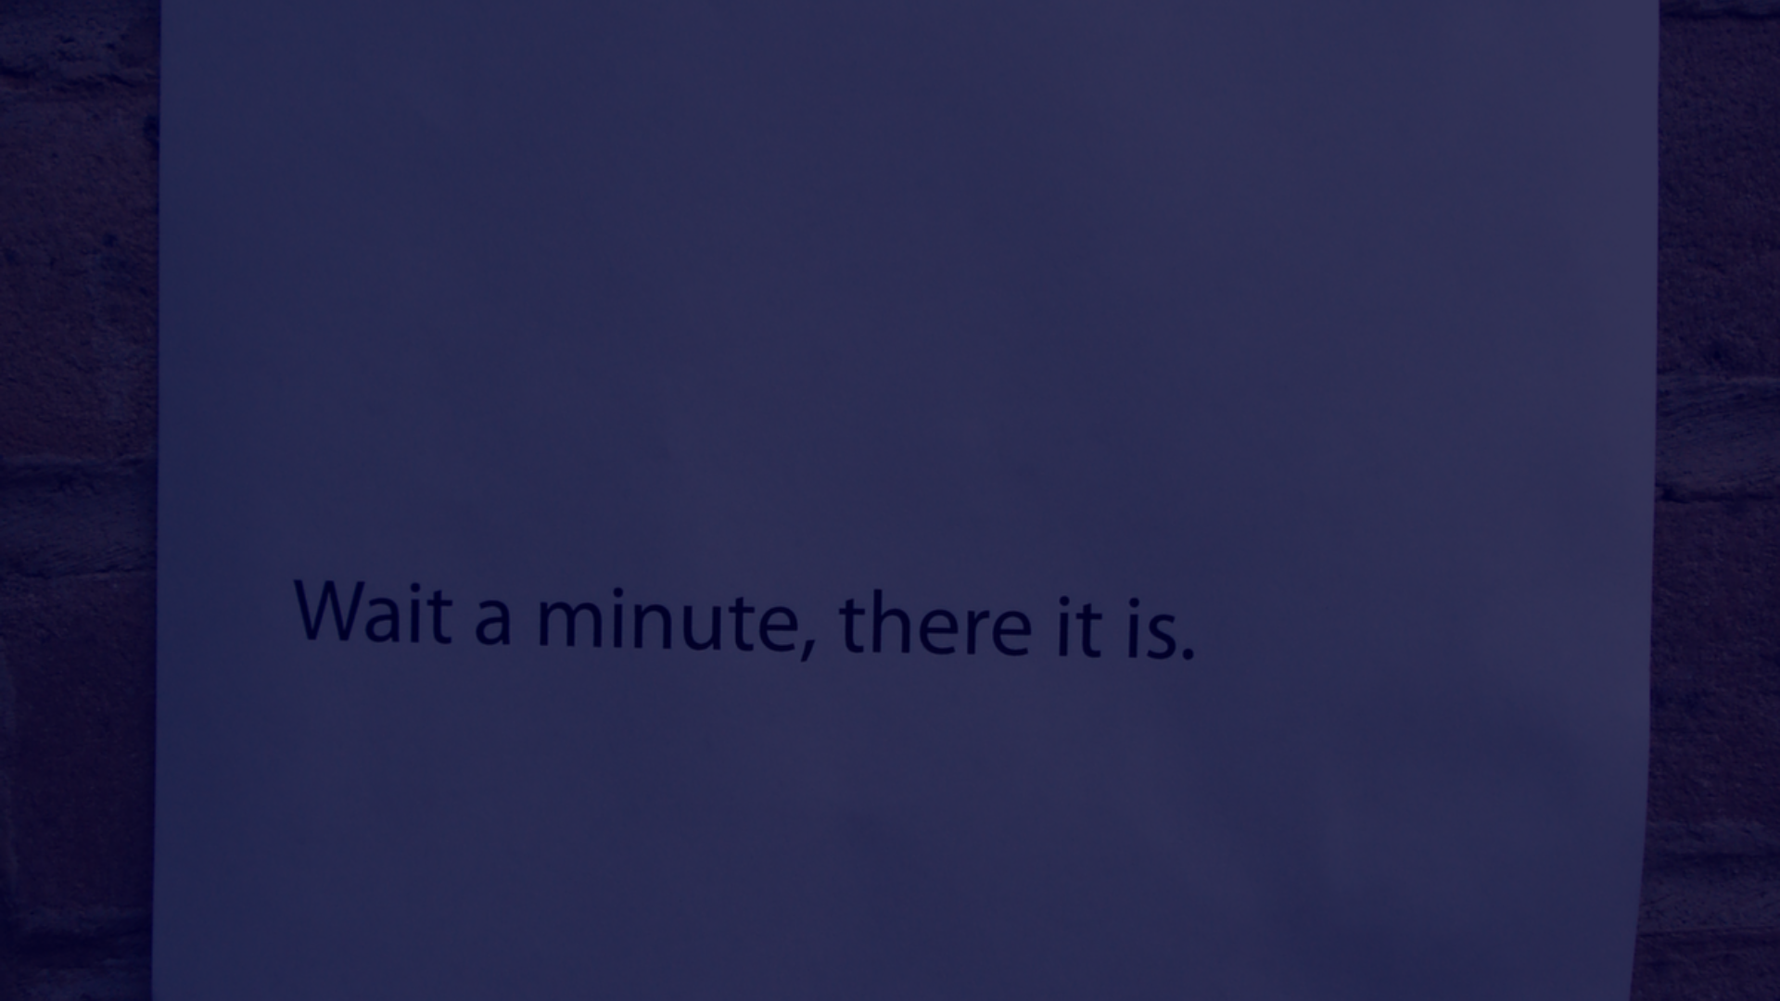
Introduction
Welcome, everyone, to this presentation on our innovative project, the "Lost & Found Items Management System." In a world where belongings can easily be misplaced, our project aims to streamline the process of locating lost items and reuniting them with their rightful owners. Through a user-friendly interface and efficient tracking mechanisms, we strive to create a seamless experience for both individuals who lose items and those who find them. Join us as we explore the features and benefits of our Lost & Found system, designed to bring order to the chaos of lost possessions.
.

Slide 3
Abstraction
This presentation explores the development and implementation of a comprehensive Lost & Found system, designed to streamline the process of locating and reclaiming misplaced items. The project focuses on creating a user-friendly platform that centralizes lost and found information, enhancing efficiency for both administrators and users. Key features include advanced search functionalities, real-time updates, and a secure database, ensuring a seamless experience for individuals seeking lost items and facilitating their swift recovery.
.

Slide 4
Key Features and Functionality
Item Tracking
Claim Management
Reporting and Analytics
The software enables detailed tracking of lost and found items, including item descriptions, dates, and locations of discovery.
It facilitates the process of managing claims from individuals seeking to retrieve their lost items, ensuring transparency and proper documentation.
Provides insights through reporting and analytics, allowing organizations to identify trends and optimize their lost and found processes.

Slide 5
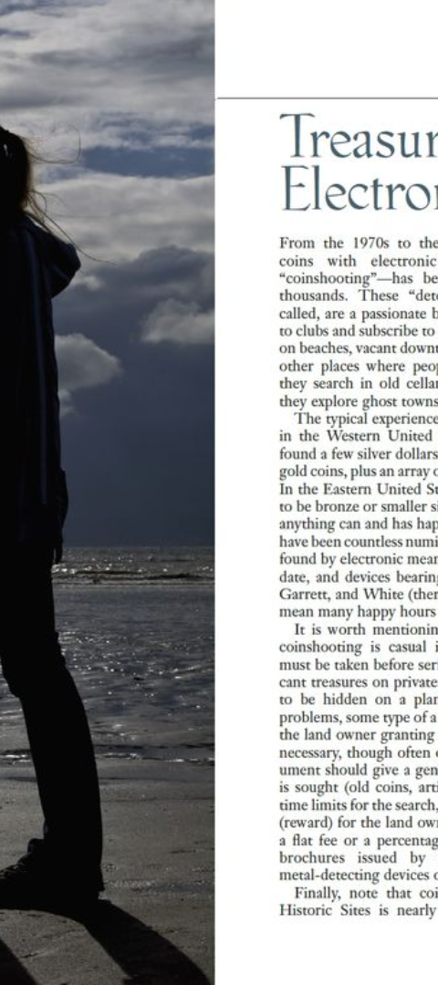
Benefits of Using Lost & Found Software
1
Enhanced Efficiency
2
Improved Customer Experience
The software streamlines the lost and found process, enabling staff to manage items more effectively and reduce the time required for item retrieval.
Organizations can provide a better customer experience by quickly and accurately reuniting lost items with their owners.
3
Data Centralization
Centralized data storage simplifies tracking and management, reducing the likelihood of items being misplaced or forgotten.

Slide 6
Security and Data Privacy Measures
Access Control
Regulatory Compliance
Granular access control mechanisms are in place to restrict access based on user roles and permissions.
Adheres to industry standards and regulations to protect user privacy and data integrity.

